Slide 1
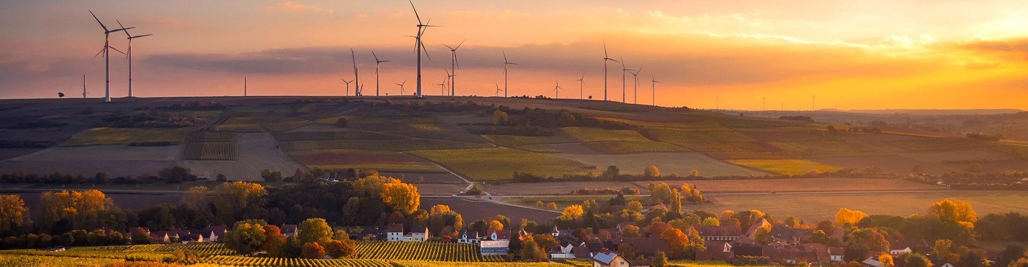

Bioeconomy, Biorefineries & Bio-based plastics – opportunities for rural areas
Circular Economy in Plastics Industry
13.11.2019
Tommy Alexander Schmid I BIOPRO Baden-Württemberg GmbH
(iöw)

Slide 2
Disclaimer
This presentation is for internal use by the participants of the conference only and shall not be used or published in any way beyond that.

Slide 3
Agenda
BIOPRO Baden-Württemberg GmbH
The bioeconomy & its value for rural areas
Biorefineries - Key role in the successful transition towards a bioeconomy
B4B – Biorefinery for Baden-Württemberg

Slide 4



BIOPRO Baden-Württemberg GmbH
Pooling competencies – pushing innovations
Funded by:
We are...
...a science communication and economic development agency.
...funded by several ministries.
...contributing to the positive development of Baden-Württemberg.

Slide 5
BIOPRO Baden-Württemberg GmbH
Pooling competencies – pushing innovations
We...
… work in partnership with science, the economic sector and business and science networks.
… contribute to cross-sectoral cooperation across the entire value creation chain and hence to innovation.
… offer support for technology transfer and start-up projects.
… provide you with comprehensive information.

Slide 6

The bioeconomy & its value for rural areas
Bioeconomy, Circular-Economy, Cascading-Use

Slide 7


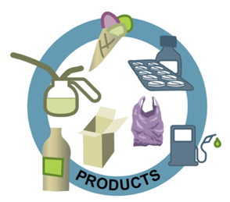
The bioeconomy & its value for rural areas
?
Notes:
?

Slide 8
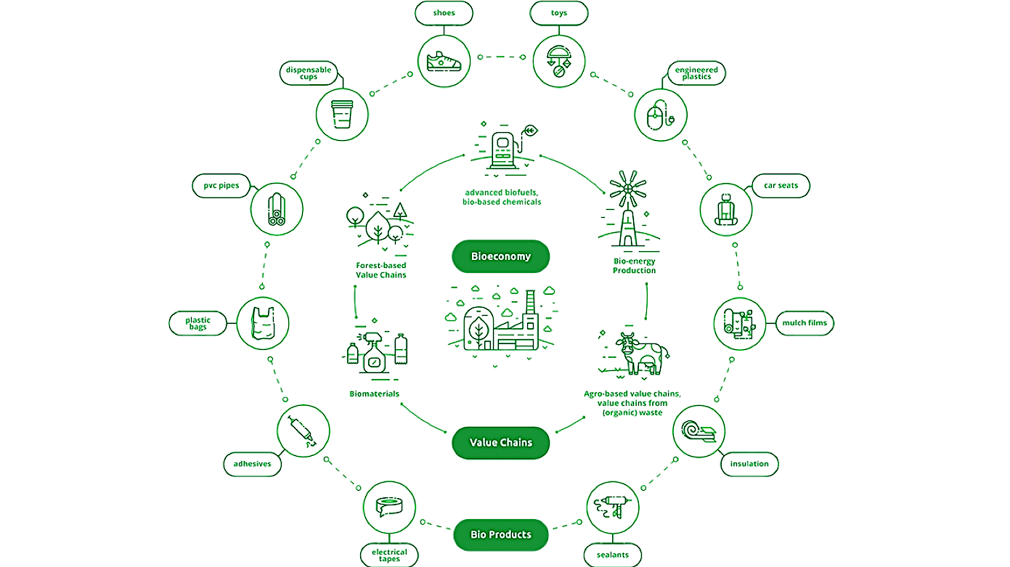
The bioeconomy & its value for rural areas
(EU 2008)

Slide 9
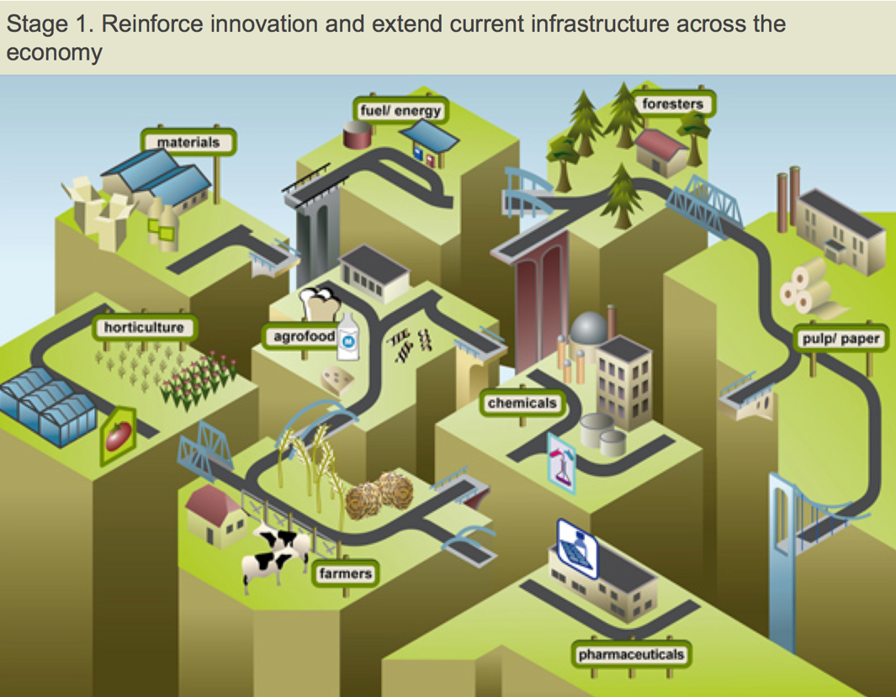
The bioeconomy & its value for rural areas
http://biconsortium.eu/sites/biconsortium.eu/files/work-images/Bridge-transition-3.jpg
Picture: Biobased Industries Consortium (BIC), Brüssel

Slide 10
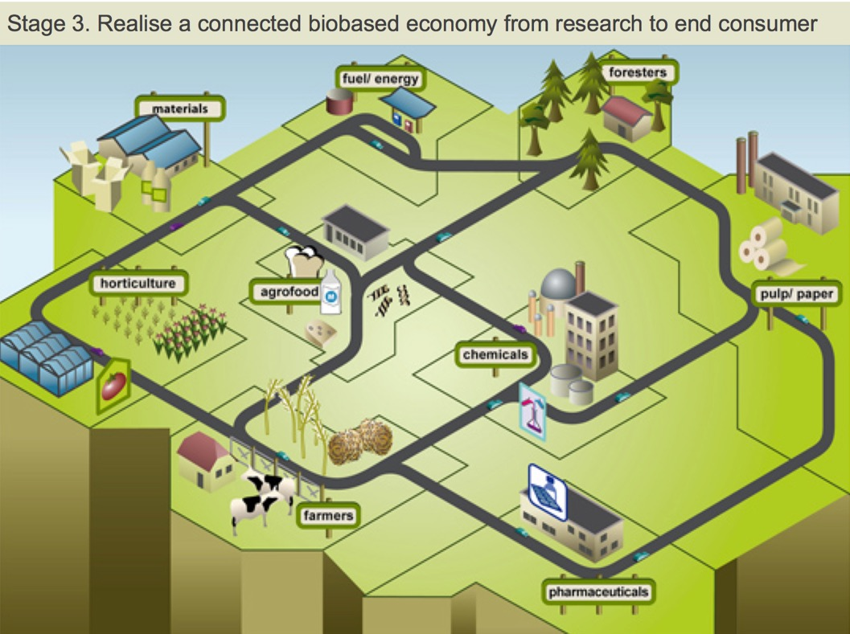
The bioeconomy & its value for rural areas
Picture : Biobased Industries Consortium (BIC), Brüssel

Slide 11
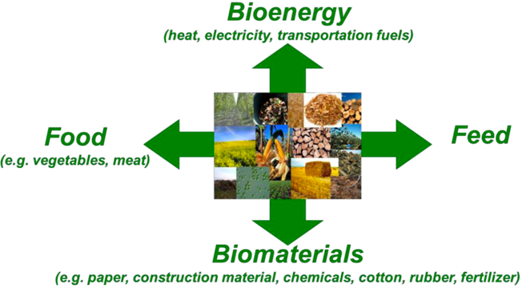
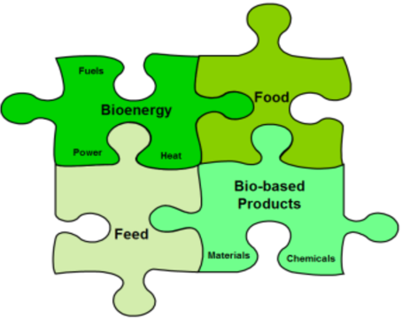
The bioeconomy & its value for rural areas
(JOANNEUM RESEARCH)
(JOANNEUM RESEARCH)
Competition
Integration

Slide 12

The bioeconomy & its value for rural areas
Benefits for the rural area
Value creation and employment
→ Regional added value (taxes, ...).
→ Financial participation schemes
(cooperatives, ...).
Achieving synergies
→ Strengthening of the economic
and ecological base.
→ Support of societal goals (Biodiversity etc.).
Strengthening a sense of regional identity
→ Development opportunities & relevance.
→ Common future task.
(Fotolia/vege)
(iöw 2018)

Slide 13
The bioeconomy & its value for rural areas
Feedstock
Use of already existing material-streams
(biomass (residues)/municipal/industrial).
Cultivation of new biomass crops.
Infrastructure
Use/Development of already existing infrastructure (biogas plants, sawmills, etc.).
Building new infrastructure.

Slide 14
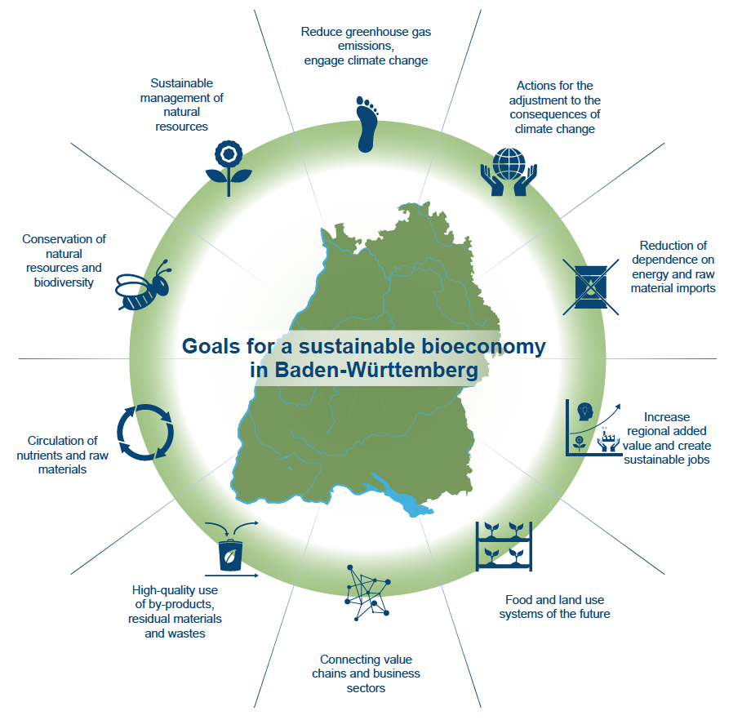
Policy-Strategy
“Sustainable Bioeconomy Baden-Württemberg”
04.06.2019
(Copyright BIOPRO)

Slide 15
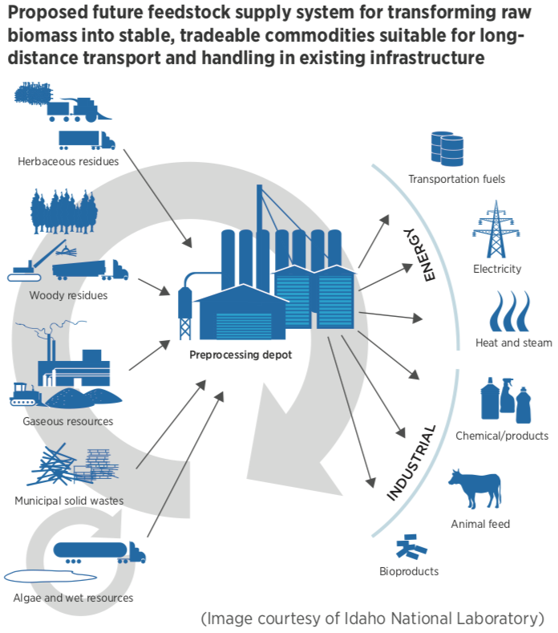
Biorefineries - Key role in the transition to a bioeconomy
Building small & modular, feedstock-
flexible biorefineries.
Integration into existing value-chains.
Development of new value-chains
depending on existing side- and
wastestreams.

Slide 16
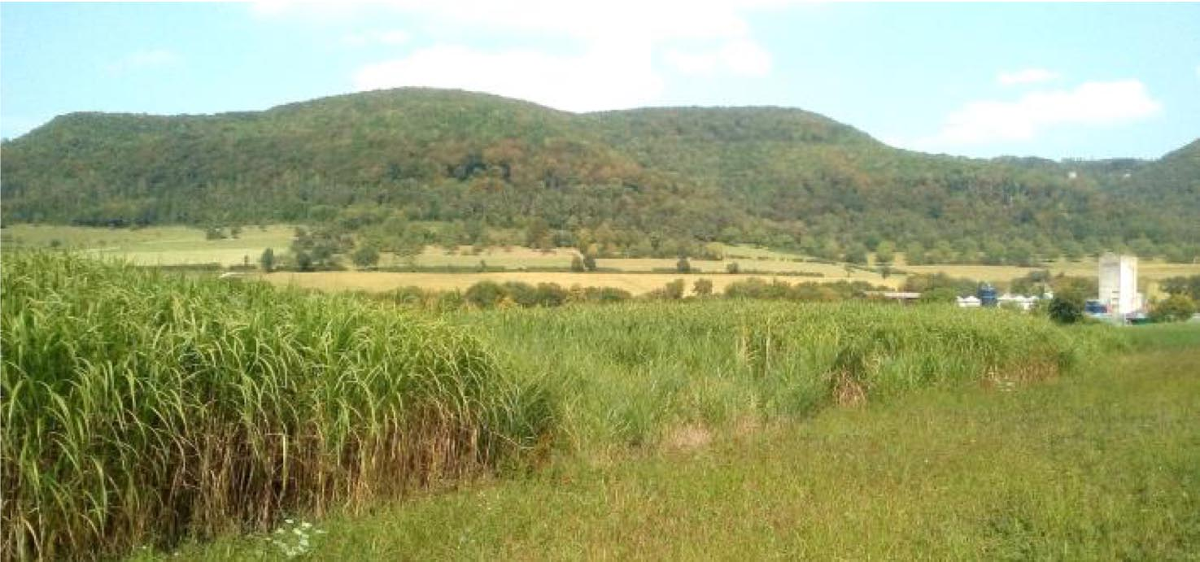
B4B – Biorefinery for the bioeconomy in Baden-Württemberg
Feedstock
Miscanthus
x gigantheus.
Cultivation on marginal-lands.
No competition with food production.
Copyright: University of Hohenheim

Slide 17
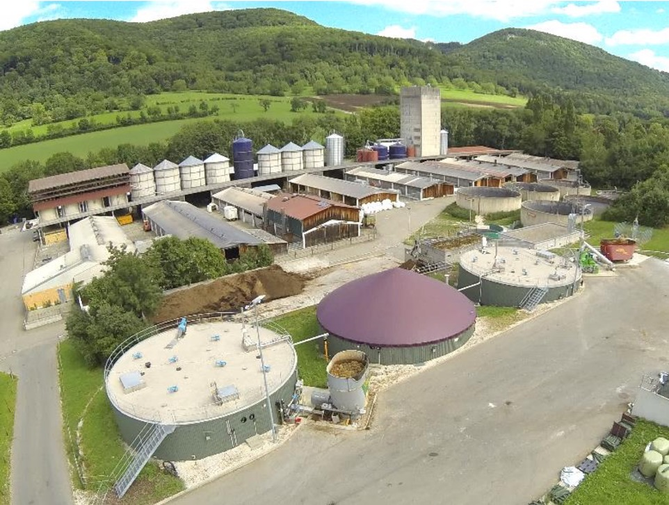
B4B – Biorefinery for the bioeconomy in Baden-Württemberg
„Unterer Lindenhof“: Research-farm of the University of Hohenheim.
Construction of a small-scale pilot plant.
Biogas-Plant in infrastructure concept:
→ Circular Approach
Copyright: University of Hohenheim

Slide 18
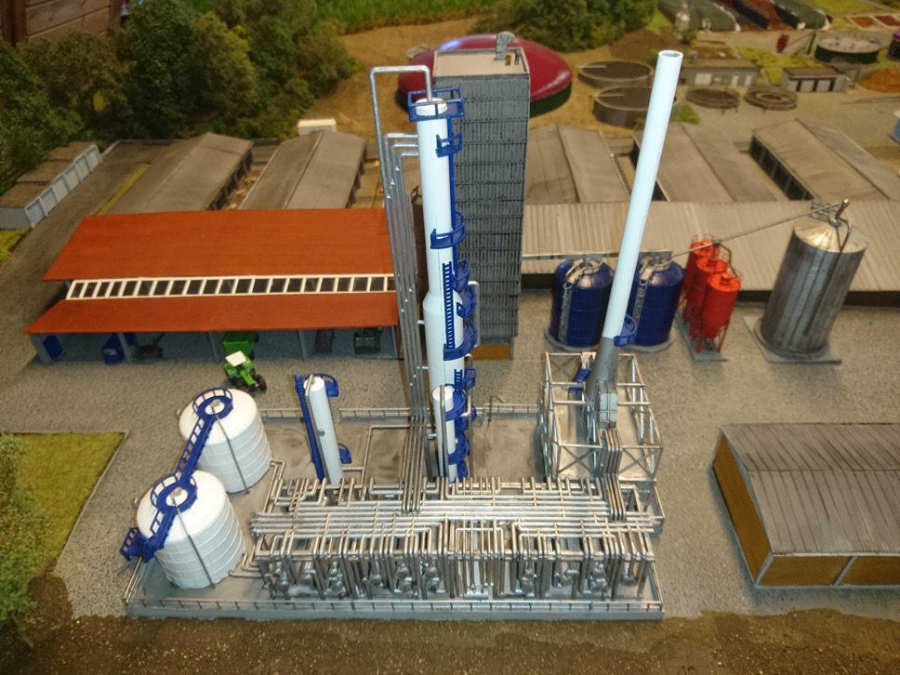
B4B – Biorefinery for the bioeconomy in Baden-Württemberg
Different possible scaling-scenarios.
„On-Farm“-Scenario up to „Sugar-Plant“-Scenario.
Picture:
Potential „On-Farm“-Scenario.
Copyright: University of Hohenheim

Slide 19



B4B – Biorefinery for the bioeconomy in Baden-Württemberg
Cellulose
43-52 %
Hydroxymethyl-furfural (HMF)
Hemicellulose
25-34 %
Furfural
Bio-Aromatics
Lignin
9-13 %
Piktogram: Icon made by Freepik from www.flaticon.com

Slide 20
B4B – Biorefinery for the bioeconomy in Baden-Württemberg
HMF → FDCA → PEF
Picture missing due to Copyright. For further information about PEF, see
https://ava-biochem.com/service/polyethylene-furanoate/

Slide 21
Summary
Focus on rural areas as biomass producers
Keeping the value added activities in the rural area (if possible, small-scale scenarios)
Sustainable plastics and materials production as a way to foster regional value-chains
Circular approach by design

Slide 23
Vielen Dank für Ihre Aufmerksamkeit
Contact:
www.bio-pro.de
www.biooekonomie-bw.de
(iöw)

Slide 24
Literature
COMMUNICATION FROM THE COMMISSION TO THE EUROPEAN PARLIAMENT, THE COUNCIL, THE EUROPEAN ECONOMIC AND SOCIAL COMMITTEE AND THE COMMITTEE OF THE REGIONS: A sustainable Bioeconomy for Europe: Strengthening the connection between economy, society and the environment, European Commission, 2018.
https://eur-lex.europa.eu/legal-content/EN/TXT/PDF/?uri=CELEX:52018DC0673&from=EN
ENRD: European Network for Rural Development, EU RURAL REVIEW No 23, 24, 25. European Union, 2017.
Mangoyana & Smith: Decentralised bioenergy systems: A review of opportunities and threats. In: Energy Policy 39(3):1286-1295 · March 2011.
Iöw: Institut für ökologische Wirtschaftsförderung. Ländliche Bioökonomie: Stärkung des ländlichen Raumes durch eigene dezentrale bioökonomische Ansätze. Projektbericht. 2018.
Priefer et al.: Pathways to Shape the Bioeconomy. In: Resources 6(10):1-23. März 2017.
Piktogram Slide 18: Icon made by Freepik from www.flaticon.com

