Slide 1
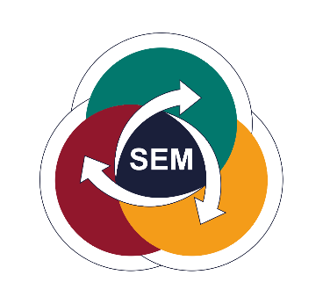


SCALE UP
TO WIN
TOGETHER
Nestlé Adriatic Journey
on Environmental Sustainability

Slide 2
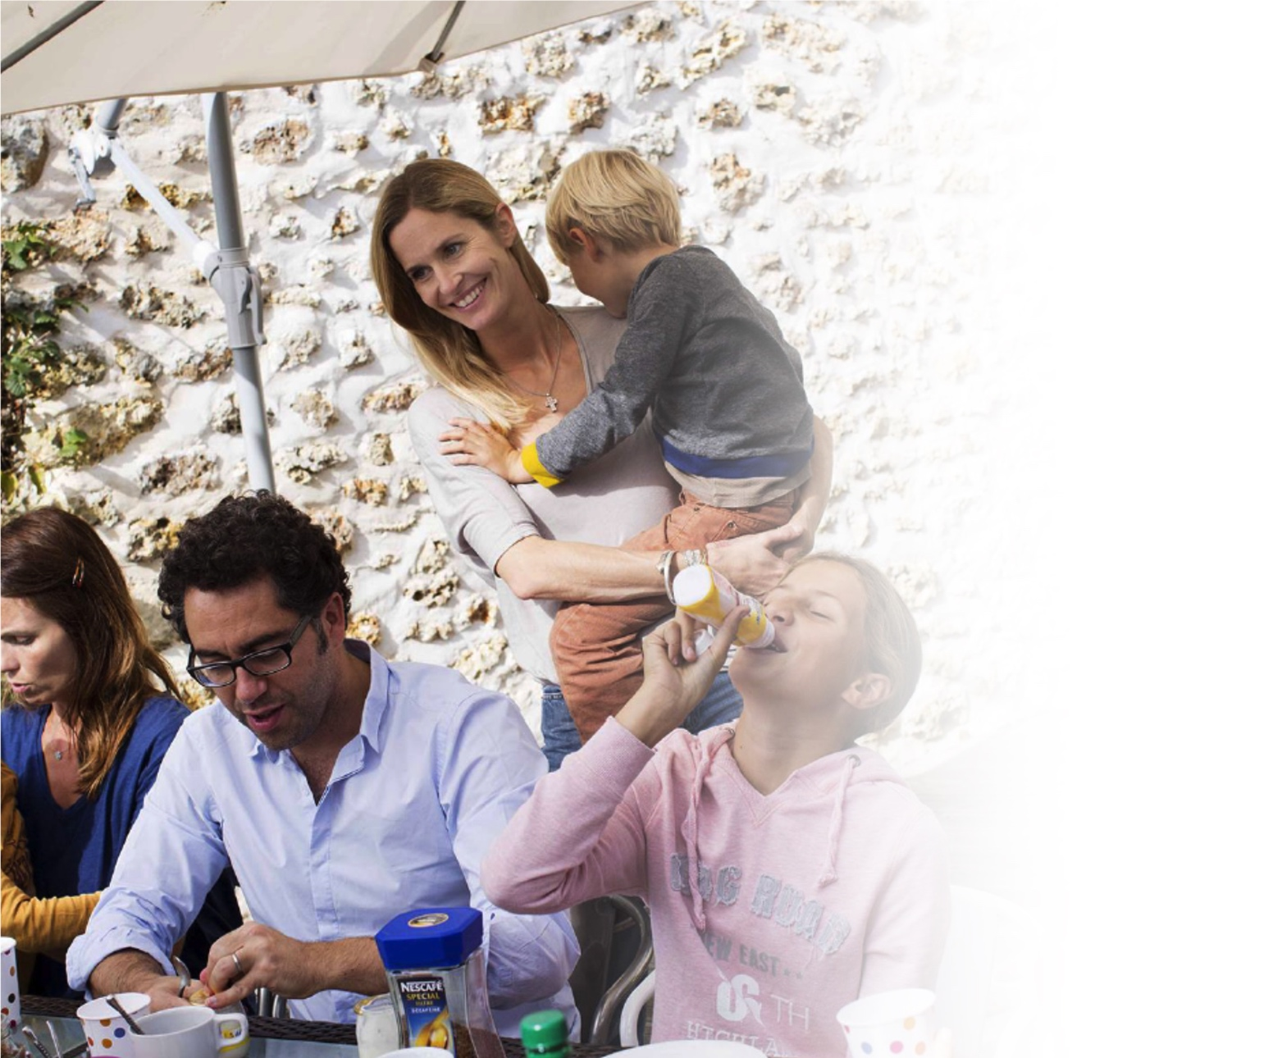



SCALE UP TO WIN TOGETHER
Nestlé at a glance
CHF 91 439 million in sales in 2018
308 000 employers in over 2019 countries
413 factories in 85 countries
Over 2 000 brands
1 billion Nestlé products sold every day

Slide 3
SCALE UP TO WIN TOGETHER
Nestlé Adriatic at a glance
9 Countries
4 Hubs of Expertize
2200+ employees
Growing business over 0,5 bio CHF
2 factories (Serbia, Bulgaria)
11 Categories, over 35 brands
1000+ products

Slide 4
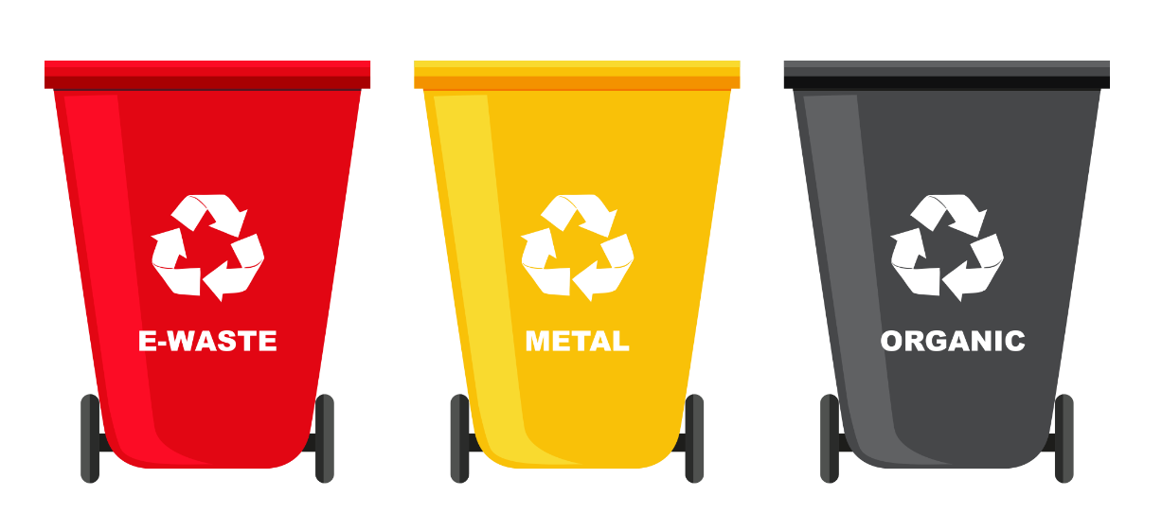

Nestlé Global Commitments (summary)
In 2019 Nestlé inaugurates packaging research institute, first-of-its-kind in the food industry.
By 2020, we have commitment that all our Factories will be 0 Waste to Landfill
By 2025, 100% of our packaging will be reusable or recyclable.
Nestlé announced its ambition to achieve zero net greenhouse gas emissions by 2050.
____
2019 Institute for Packagig
SCALE UP TO WIN TOGETHER

Slide 5
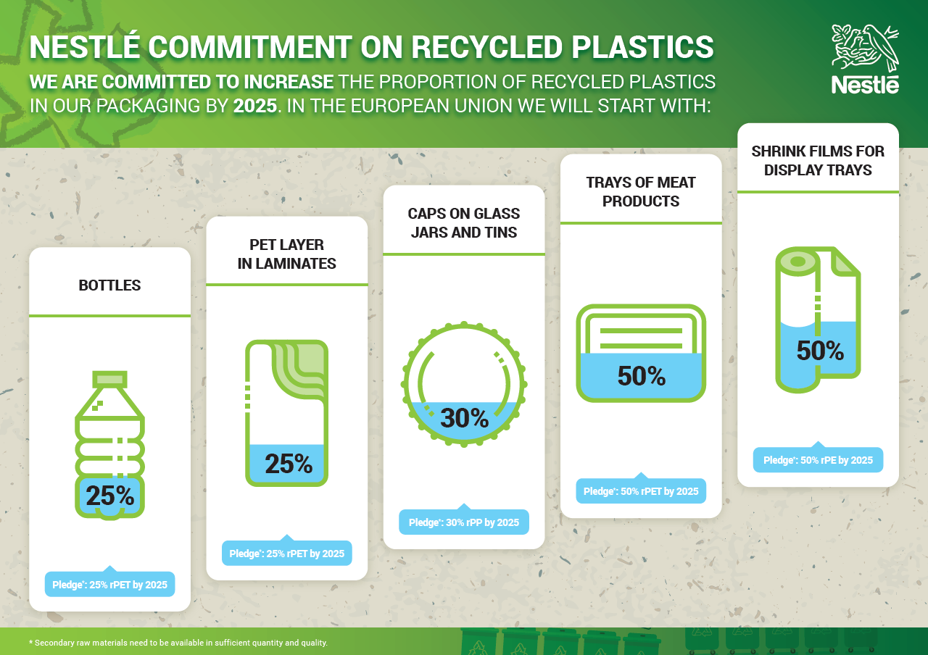
SCALE UP TO WIN TOGETHER

Slide 6
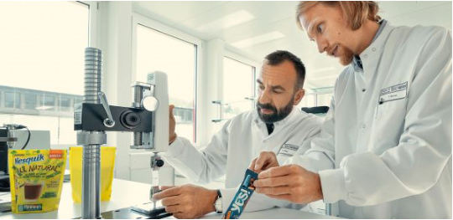
Nestlé inaugurates packaging research institute
Nestlé inaugurates packaging research institute, first-of-its-kind in the food industry.
The new Institute enables Nestlé to accelerate its efforts to bring functional, safe and environmentally friendly packaging solutions to the market and to address the global challenge of plastic packaging waste.
The Nestlé Institute of Packaging Sciences focuses on a number of science and technology areas, such as refillable or reusable packaging, simplified packaging materials, recycled packaging materials, high-performance barrier papers as well as bio-based, compostable and biodegradable materials.
Nestlé is already making progress towards its 2025 packaging commitments, and has launched novel packaging solutions. For example, Nestlé packaging experts and suppliers developed products in recyclable paper packaging such as the Nesquik All Natural cocoa powder and the YES! snack bars under 12 months.
SCALE UP TO WIN TOGETHER

Slide 7
















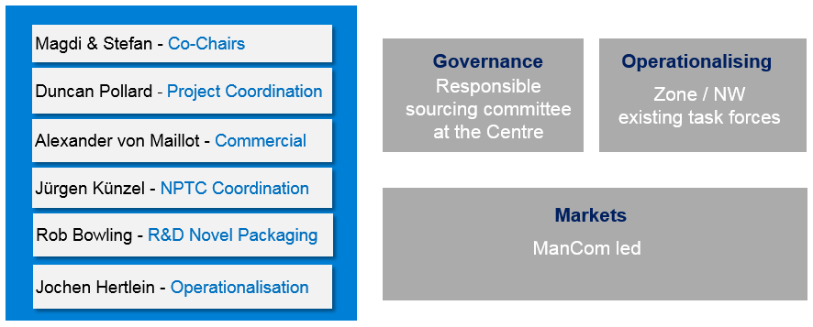



Nestlé Roadmap
MATERIALS
& DESIGN
RECYCLED CONTENT
COLLABORATION & ENGAGEMENT
ADVOCACY
ELIMINATE
PVC,
ePS,
PS
RECYCLING INFRASTRUCTURE
GOVERNANCE
FUNDING
COMMUNICATION
SCALE UP TO WIN TOGETHER

Slide 8

Nestlé Adriatic Roadmap
Change of plastics packaging towards recyclable and increased recycled content
Change of composite flexible packaging specification
Eliminate PVC films (if any)
Increase proportion of recycled packaging (PET layer in laminates, PE in shrink films)
KPI: # of specs changed for recyclability and/or recycled
Be recognized as a company caring for the environment and a government partner
Strong collaboration with Public Authorities
Advocacy actions for new legislative proposal on national/EU level
Increase collection & recycling rates
Support introduction of new stream or expansion of existing channels for collection of recyclables
Participation in clean - up initiatives
Drive creation of PET recycling facilities
KPI: Collection Rate; We are still working on Target for every country
Build awareness on collection, sorting & recycling
Nestle campaigns (Internal & External)
Joint initiatives with partners (awareness campaigns, round tables, etc.)
Participation in environmental forums
KPI: % Employees Engaged
SCALE UP TO WIN TOGETHER

Slide 9
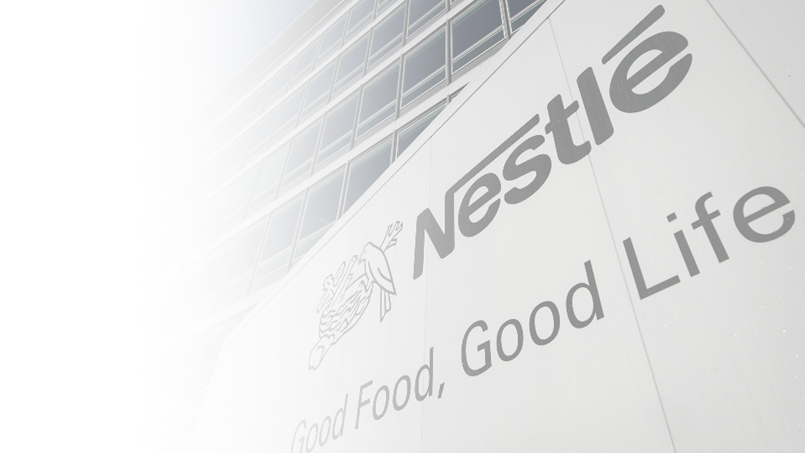
Nestlé Adriatic - Surčin Factory at a glance
In Nestlé
family –
8 years
Suppliers – 52% suppliers from
Serbia /150 suppliers total
159
different
recipes
271 employees (25% millenials)
2018/2019 –
15 000 t
271
different
products
SCALE UP TO WIN TOGETHER

Slide 10
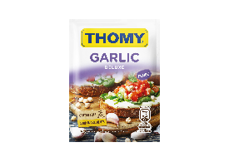
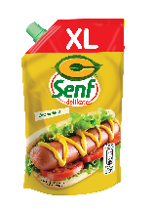
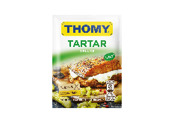
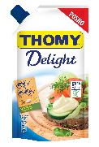

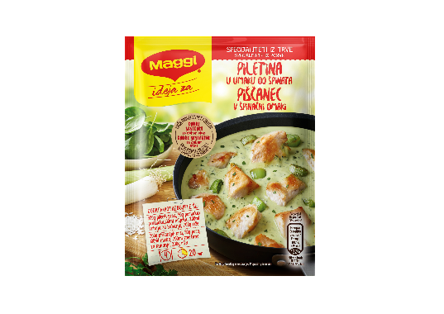
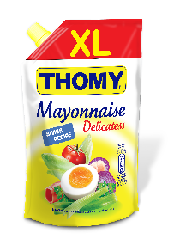

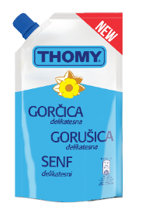
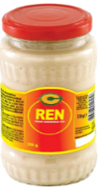
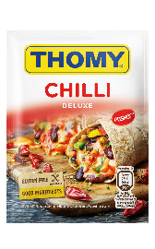
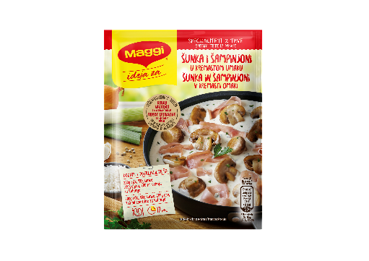
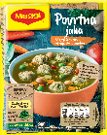
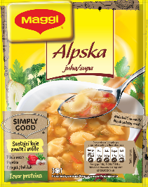
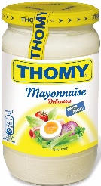


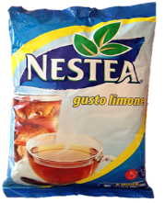

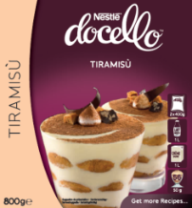
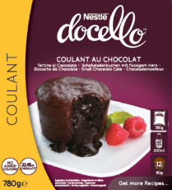










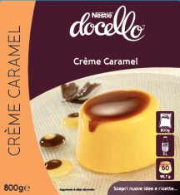
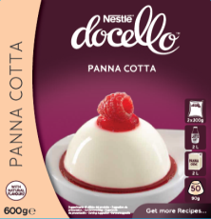





Products Groups
Wet Culinary Area
Recipe Mixes and Soups
Sweet Dehydrated and Wet NP
Mixed Seasoning and Spices
SCALE UP TO WIN TOGETHER

Slide 11
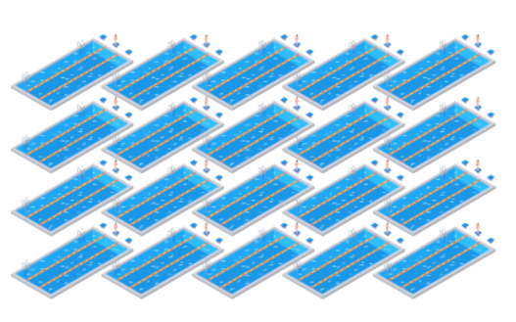
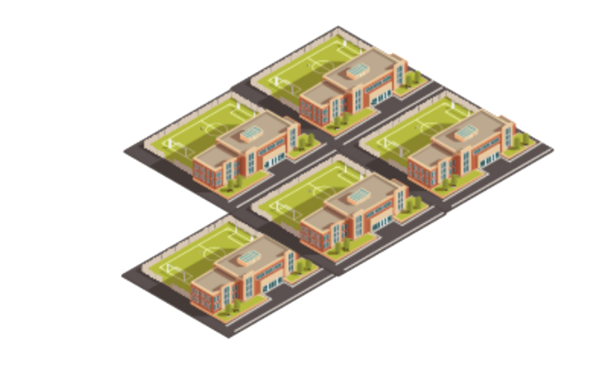
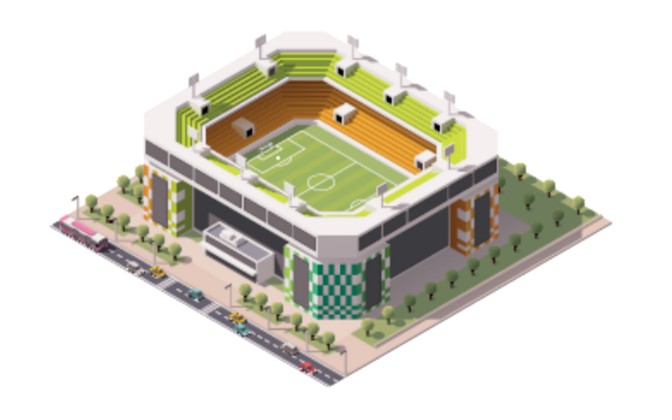
Nestlé Adriatic results on Environment Sustainability
Some figures…
By investing 1.2 million euros, we have saved 50,000 cubic meters of water, quantity enough to fill 20 Olympic swimming pools!
Energy consumption got down 19.5% - we succeeded to decrease our electricity consumption for half a million kilowatts, which is equivalent to the amount consumed by 5 primary schools annually.
By altering the designs and dimensions of C and MAGGI brand packages, in a year, the factory will reduce the consumption by 61 tons of paper and 6 tons of plastic, which is, just for scale, enough to cover a whole football field.
SCALE UP TO WIN TOGETHER

Slide 12
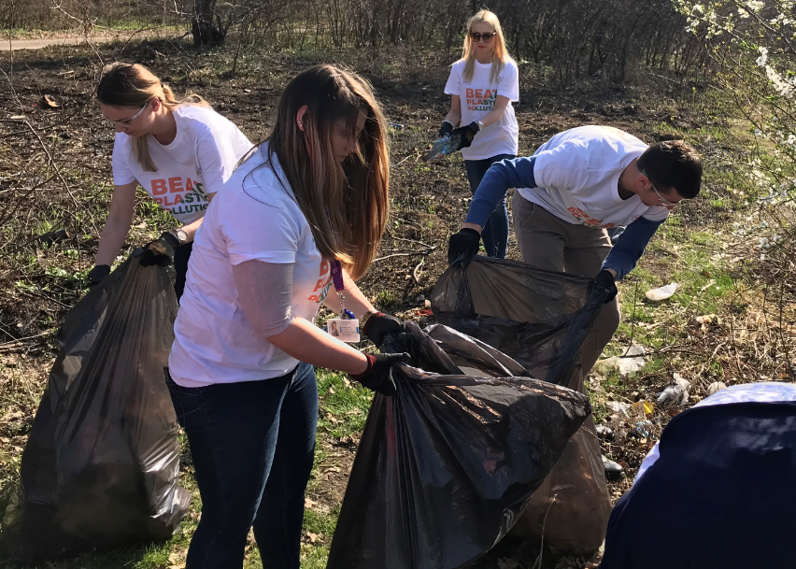
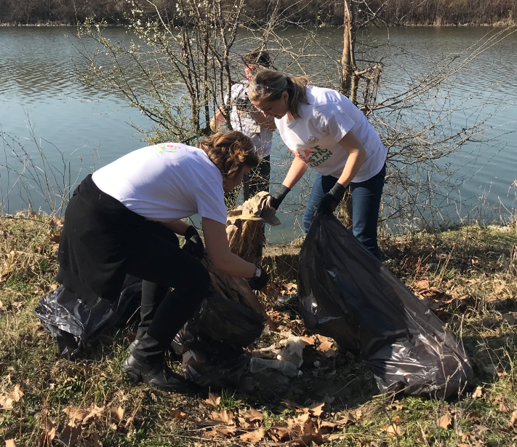
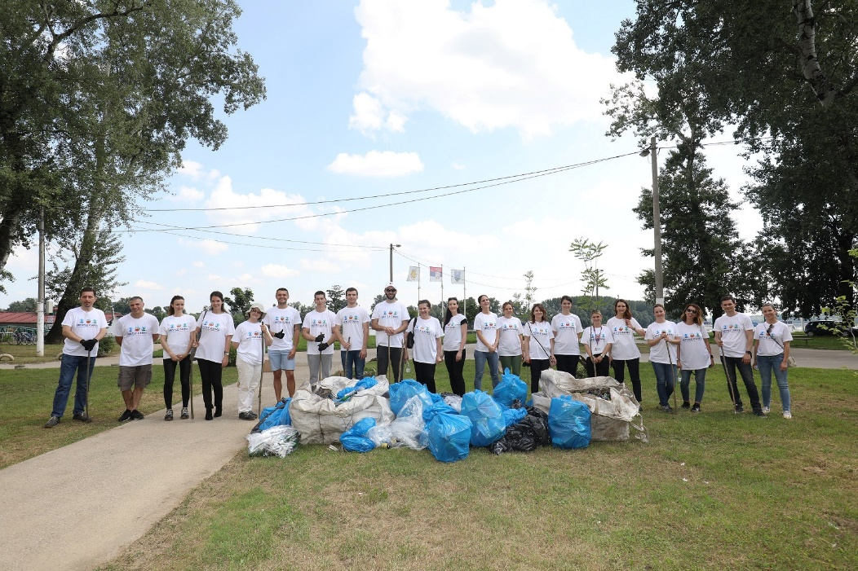
Nestlé Adriatic employees engagement on Sustainability
World Recycling Day 18th of March, World Ocean day 8th June
    Event with our employees who were collecting plastic waste from environment
    More than 500kg of waste collected, 50 employees participated together with local community
SCALE UP TO WIN TOGETHER

Slide 13

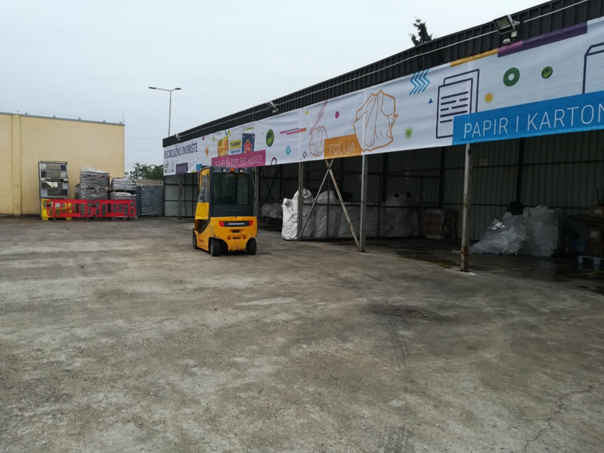
Zero Waste to Landfill Surčin Master Plan
Target = Latest December 31st 2019
BASELINE
Landfill – 13 tons/month
IMPROVEMENTS
STAGE 1 - Q4 2018
  Outsource waste management in Factory yard – outside od production area
  Implement new way of waste transportation
  Install additional waste press machine
  Start to collect and recycle raw waste from production
  Result : Reduction 50% of communal waste
STAGE 2 – Q1 2019 end of Q1 2019, full segregation of waste in the factory
Sorting and pressing packaging waste from Dry culinary area.
Sorting and pressing packaging waste from Wet culinary area
  Result: Reduction 75% of communal waste
STAGE 3 – Q2 AND Q3 2019 full segregation of waste in the factory
A. Organize waste segregation in Admin facilities
B. Find solution for organic waste
Landfill – 4 tons/month
Landfill – 0 tons
SCALE UP TO WIN TOGETHER

Slide 14
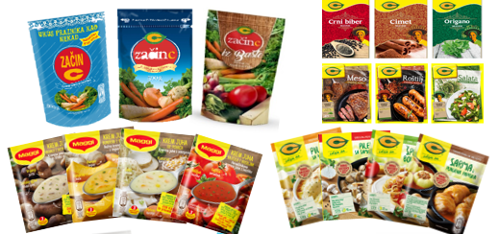
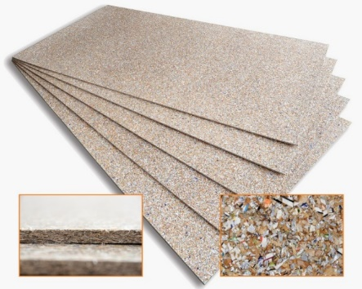
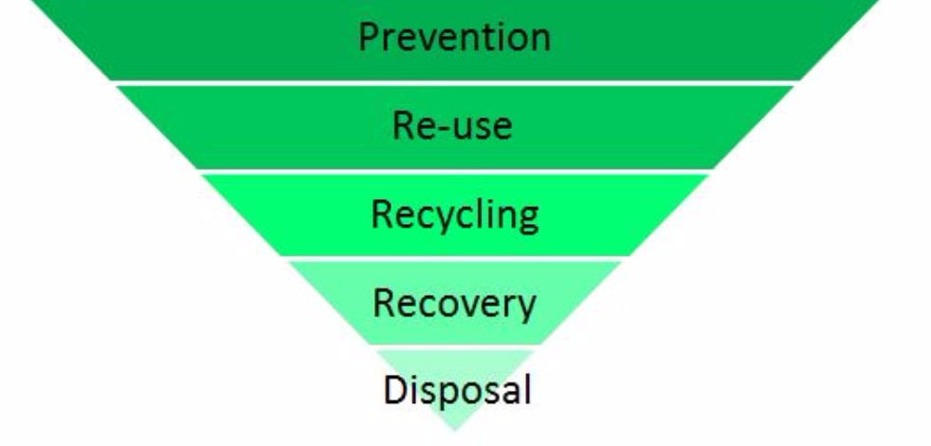
Zero Waste to Landfill Master Plan
Recycling multi-layer foil – Success story
  Before: Multi-layer foil was sent to incineration with add. cost for this service
  Together with our recycling partner Sekopak, we found a company which can use our foil as raw material to produce eco-panels.
  Eco-panels are used as materials in the construction industry, and they do not have any additives in the production process, they are 100% eco-materials.
  Eco-panels are very good isolators and waterproof.
  We reduced around 12t of foil scrap from the production, going to incineration.
  Meaning, we succeed to improve our waste management of foil, from Recovery to Reuse.
SCALE UP TO WIN TOGETHER

Slide 15
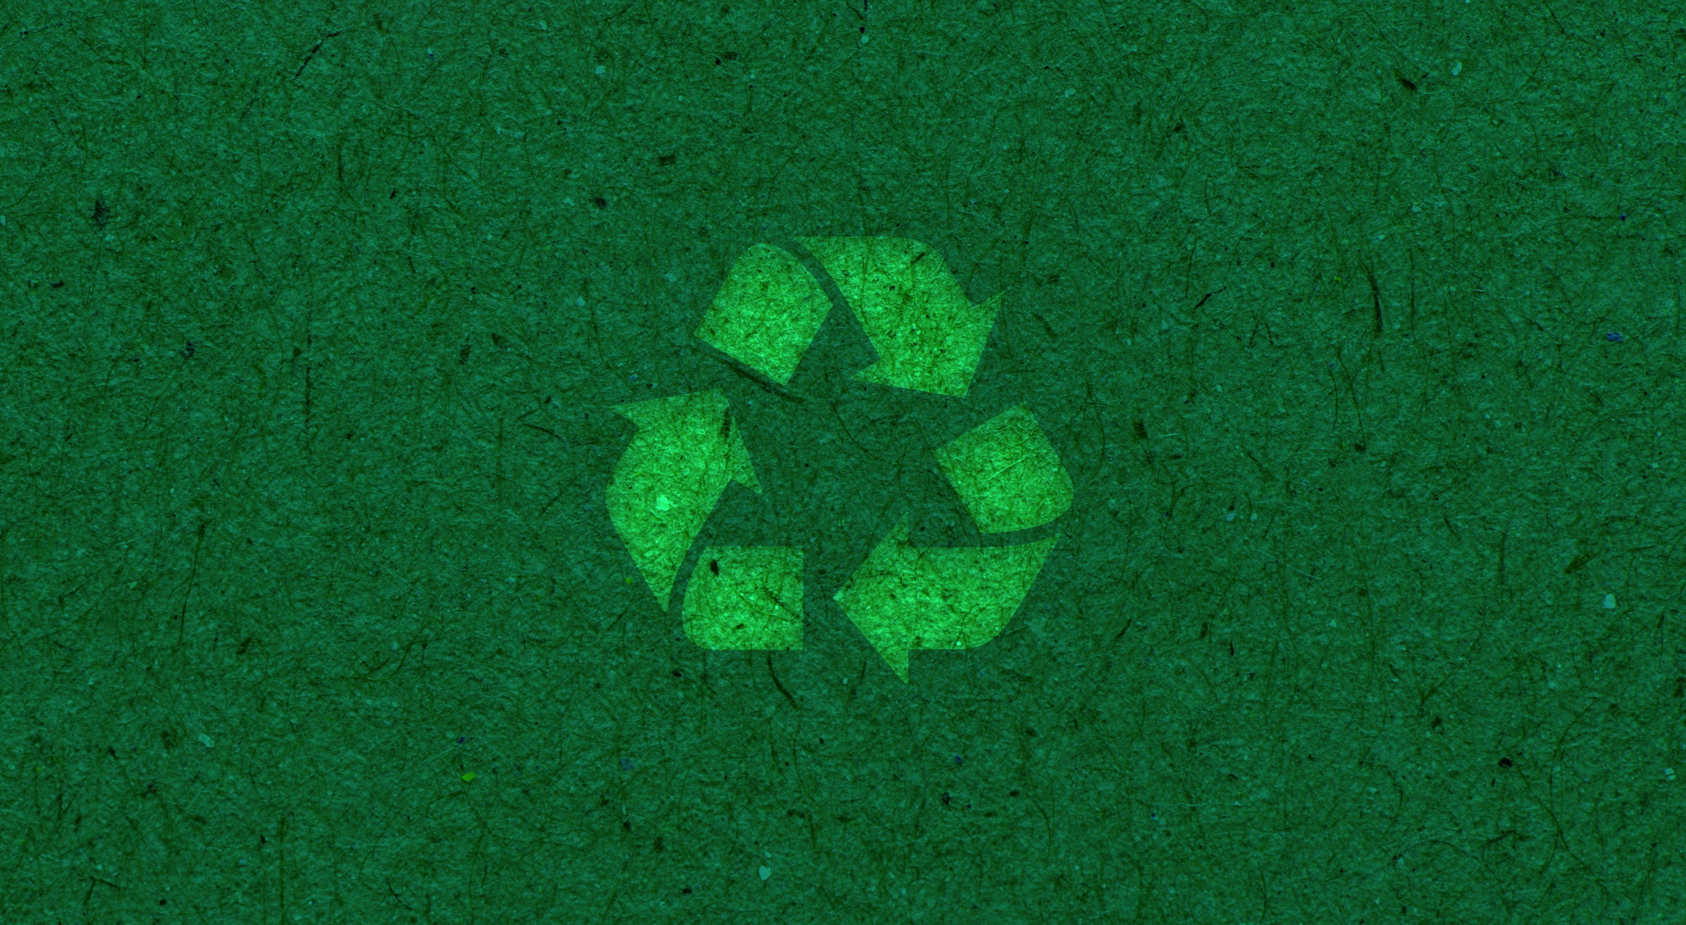


THE PLANET
Striving for zero environmental impact in our operation
SCALE UP
TO WIN
TOGETHER

